Slide 1
So far, all participants should have:
Completed and submitted a Student Entry and Information Form
Conducted Background Research
Made a Bibliography with 5 sources
What’s Next?
Visit the Rules Wizard and determine forms needed
Create a Research Plan
Fill out all forms (Do this with Parents!)
Submit forms and Research Plan for approval

Slide 2
Identify Question
The Scientific Method
Do Background Research
Construct Hypothesis
Test with an Experiment
Accept or Reject Hypothesis
Report Results

Slide 3
Your Research Plan outlines everything you propose to do. It should include:
Title: Descriptive of experiment
Purpose: What do you hope to accomplish?
Hypothesis: Clear, well worded
Independent and Dependent variables: identify how each will be measured
Materials: List all items to be used
Procedures: DETAILED!. List in order. Be specific.
Safety Procedures: The more you address, more likely project is to be approved
Bibliography with 5 sources

Slide 4
WHAT WOULD IT LOOK LIKE?
Title: Music! Harmful or Helpful?
Purpose: To determine if listening to different types of music has an affect on human heart rate and blood pressure
Hypothesis: If there is a relationship between the type of music a subject is exposed to and their heart rate and blood pressure, then a subjects heart rate and blood pressure will be highest when listening to heavy metal (high BPM) and lowest when listening to dub (low BPM).
Independent variable: type of music played (beat measured in BPM)
Dependent variable: heart rate (measured beats per minute) and blood pressure (millimeters of mercury –mmHg, systolic over diastolic) of human subjects

Slide 5
Materials: iPod with: “Go Go Gadget Gospel”- Gnarls Barkley (hip hop)
“The Word”- Junkyard Band (go-go)
“I am Ahab”- Mastodon (heavy metal)
“Robot Rock”- Daft Punk (house)
“Tidal Wave”- Lee “Scratch” Perry (dub)
Recliner
Sphygmomanometer (to measure blood pressure)
Stethoscope
Stopwatch
Twenty human subjects, 10 male, 10 female, all between 13 and 43 years old
Safety precautions : I will set the iPod volume to one-half bar (50-60dB, less than a normal conversation at 1m) to prevent hearing damage. I will screen all subjects to make sure that none suffer from high blood pressure, hypertension, irregular heart rate. I will have all students under the age of 18 fill out a parental consent form. I will have my project approved by a registered nurse who will serve as my adult sponsor.

Slide 6
Procedures:
Create a quite environment for experiment with no distractions (no TV, other people, no talking).
Select twenty human subjects. Do not select subjects with any health issues that might affect their safety or impact results. Have subjects fill out consent form. Identify each by a number. Keep forms in binder.
Place subject in reclining position, resting, with legs uncrossed.
Wrap blood pressure cuff securely around the subject’s left upper arm. Arm will be extended, palm up, and resting on chair.
Set iPod volume to one-half bar. Place the iPod earphones into the subjects ears.
Take subject’s blood pressure and pulse rate before first song and record.
Play first song for two minutes.
Take subject’s blood pressure and heart rate after song. Record.
Allow subject to relax for five minutes before playing next song. Subject may read, but should not do any activity that would increase heart rate or blood pressure.
Follow steps 2-8 for other songs.
Repeat steps 1-10 for all twenty human subjects.

Slide 7
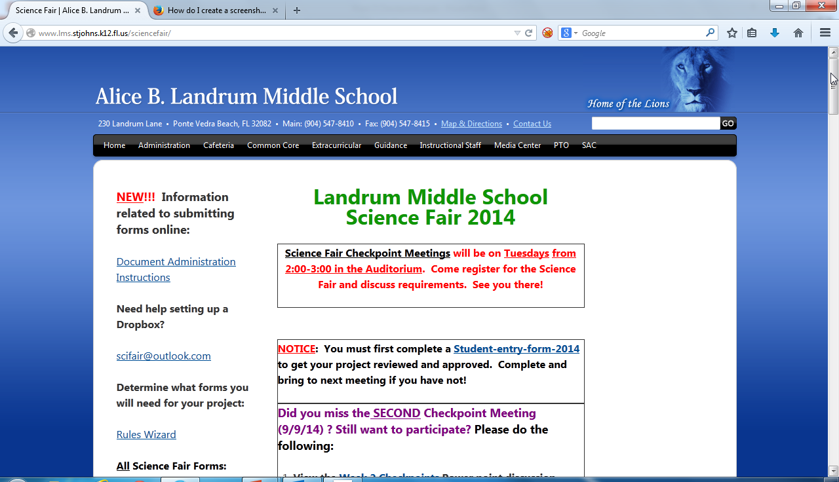

Slide 8
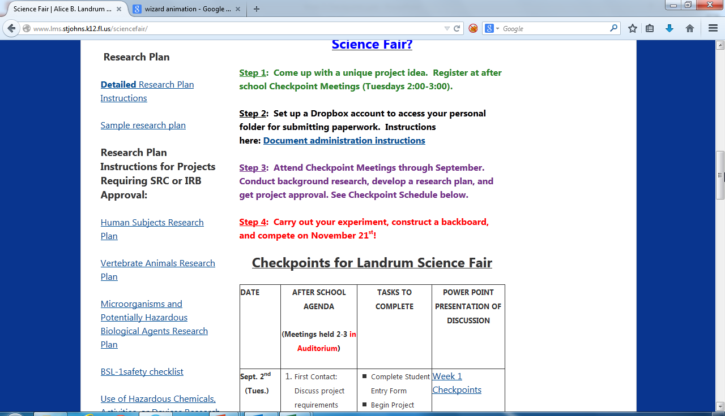

Slide 9
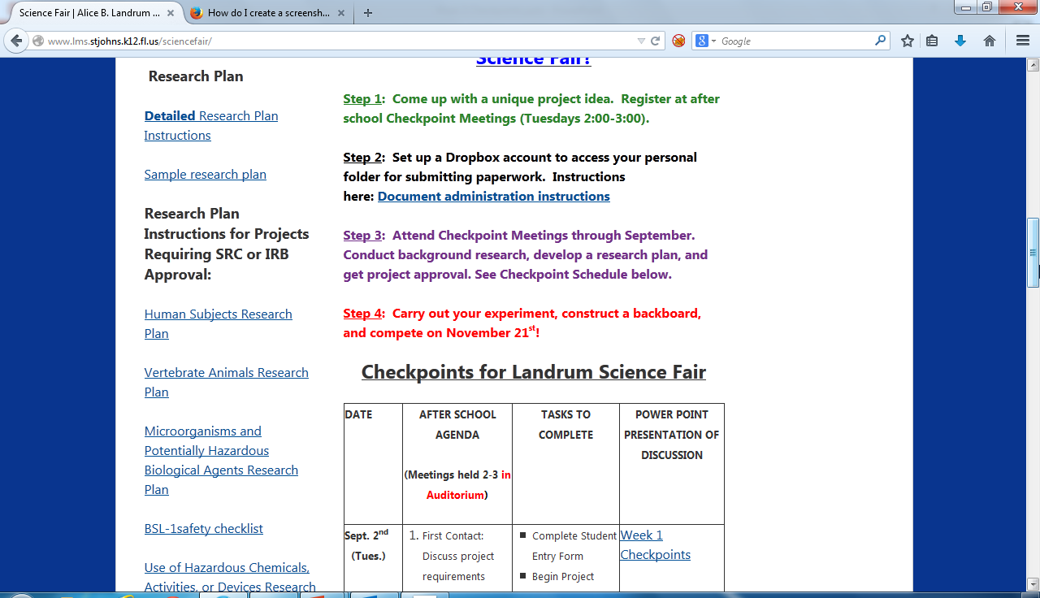

Slide 10
Which Forms Do I Fill Out?
GET YOUR PARENTS to HELP!!!
I Know Which Forms You Need!!
ALL projects require:
Form 1: Checklist for Adult Sponsor
Form 1A: Student Checklist
Form 1B: Approval Form
Research Plan (Not really a form; it’s a separate typed document)
MANY projects require:
* Form 3: Risk Assessment Form
Use blue ink for forms and signatures.

Slide 11
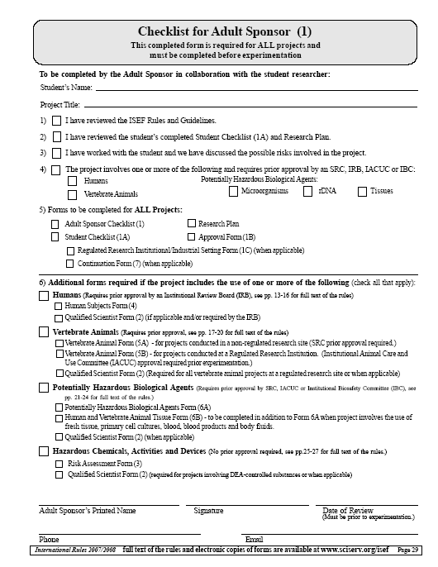
You fill out the top two lines!
Project Title must match
backboard!
ADULT SPONSOR checks appropriate boxes
Your ADULT SPONSOR—the adult person who will be supervising you while you are doing your experiment.
ADULT SPONSOR signs here

Slide 12
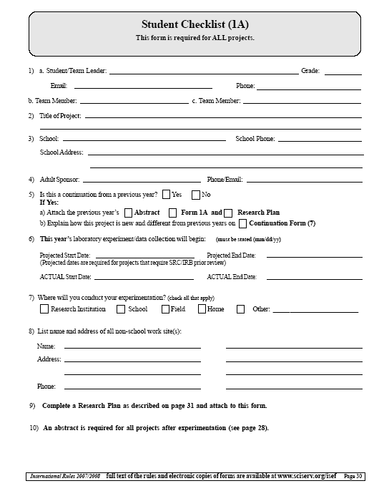
STUDENT fills out this form! Decide on a project TITLE SOON—it has to go on all forms and match what goes on your board!
IMPORTANT ! Don’t fill out ACTUAL start and end dates until later!
They should match the start and end dates of your experiment in your journal

Slide 13
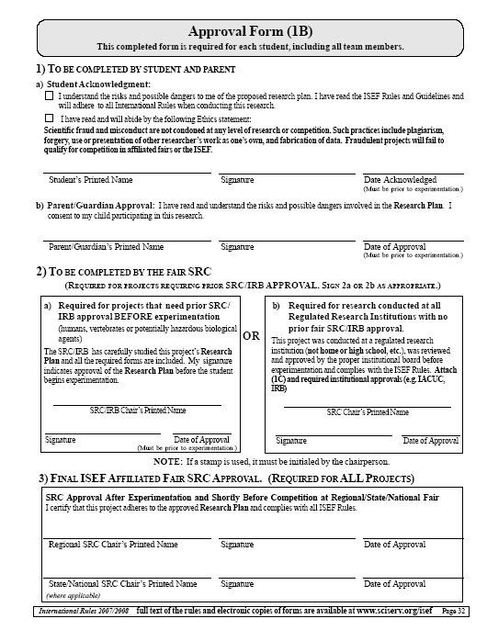
Part 1:
You and your parents must sign here.
This form must be dated BEFORE the ACTUAL start date of your experiment recorded in your log book and on Form 1A.
Part 2:
This section will be completed by the IRB/SRC if your project requires prior approval.
This section must be dated BEFORE the ACTUAL start date of your experiment recorded in your log book and on Form 1A.

Slide 14
Which Projects Require Additional Forms?
Working with:
Vertebrate animals? Form 5A (and sometimes Form 5B)
Human Subjects? Form 4 (2 pages, including Informed Consent Form)
Conducting your experiment in a Lab? Form 1C.
A professional scientist? Form 2.
Potentially dangerous chemicals or activities? Form 3.
Microorganisms or Human Tissues? Form 6A or 6B.

Slide 15
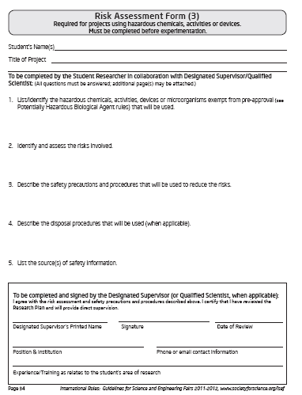
Risk Assessment: Form 3
Should YOU fill it out? FIRST, you need to write a DETAILED Research Plan.
Using Chemicals: Describe all safety precautions.
Attach MSDS sheet
Electricity: Detail safety and voltage
Dangerous Activities: Explain in detail what you will be doing and the safety measures you will follow.
WHEN IN DOUBT, FILL IT OUT!

Slide 17
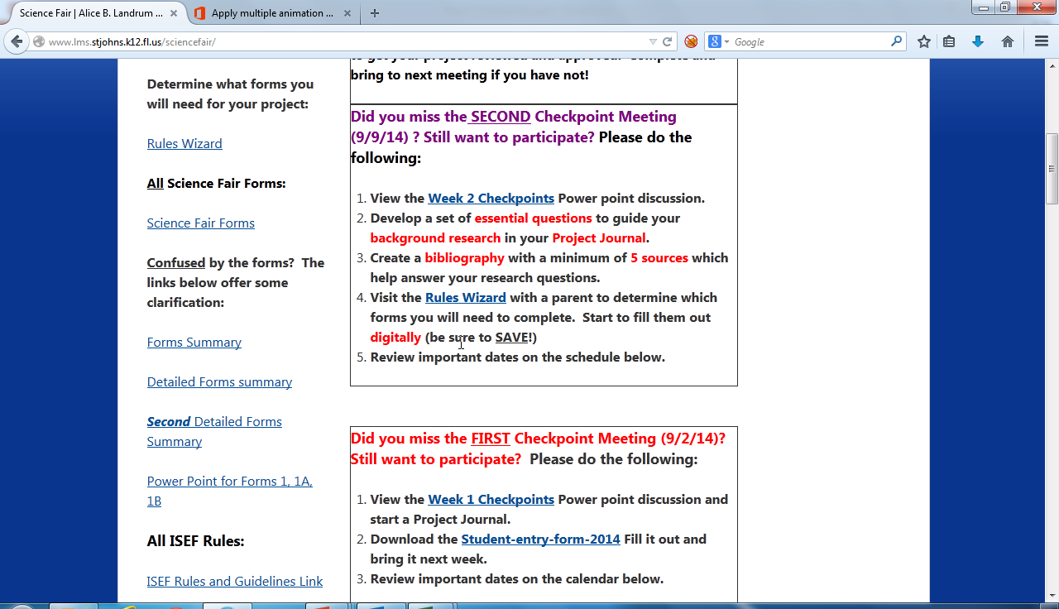

Slide 18
What Next?
Before next week……
Complete a detailed (and typed) Research Plan.
Complete all forms WITH PARENT
Print out PAPER copies of completed forms and Research Plan and bring next week.

