Slide 1
Topics to discuss today:
Creating a list of essential research questions.
Finding sources to answer research questions.
3. Creating a bibliography.
4. Visiting the rules wizard.

Slide 2
Identify Question
The Scientific Method
Do Background Research
Construct Hypothesis
Test with an Experiment
Accept or Reject Hypothesis
Report Results

Slide 3
Identify Question
The Scientific Method
Do Background Research
Construct Hypothesis
Test with an Experiment
Students conduct background research to become more knowledgeable about the topic they are about to experiment on!
Accept or Reject Hypothesis
Report Results

Slide 4
Why conduct background research?
It will help you to….
Create a better designed experiment.
Identify best tools to measure your variables
Understand existing theory behind your experiment
Determine best techniques for experimenting
Develop adequate safety procedures
Explain why your results turn out the way they do

Slide 5
Project Journal
EVERY student needs to keep a project journal
EVERYTHING you do should be recorded in
your project journal (not just your
experimental data).
DATE every entry – extremely important!!!
Use non-erasable pen, not pencil.
Do NOT tear out pages, use white out, or scribble out mistakes.
Draw ONE line (mistack) through any mistakes.
Your journal should document the process of selecting a topic, background research, rough drafts of your Research Plan, your data – EVERYTHING! -- START MAKING ENTRIES TODAY!
Mr. Anzelmo
Science Fair

Slide 6
What is your research question?

Slide 7
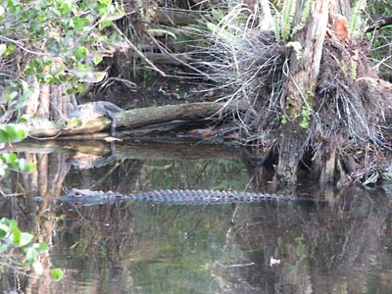
What is your research question?
Does the size of the pond affect the size of the alligators living in it?

Slide 8
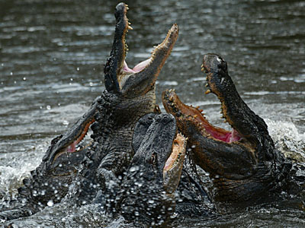
What is your hypothesis?
If there is a relationship between the size of a pond and the average size of alligators living within it, then the mean and median lengths of alligators should increase with increases in pond depth, diameter, and volume.

Slide 9
What do you know about alligators?
What do you know about measuring ponds?
You must learn as much about your topic as you can!

Slide 10
Your background research should answer questions needed to develop a valid experiment:

Slide 11
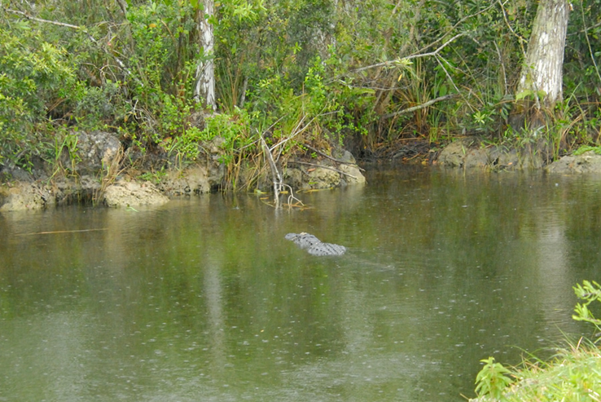
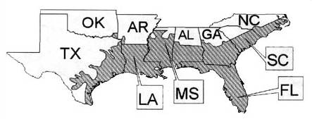
Your background research should answer questions needed to develop a valid experiment:
Where do alligators live and what is their typical habitat?

Slide 12
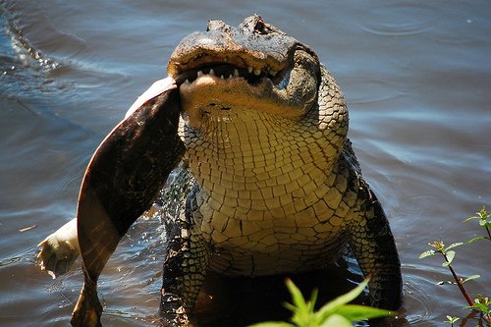
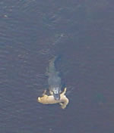
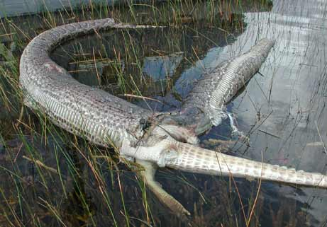
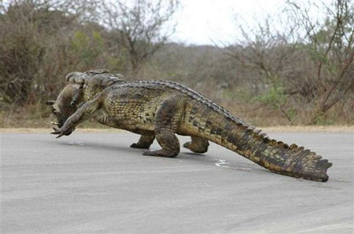
Your background research should answer questions needed to develop a valid experiment:
What do alligators eat?

Slide 13
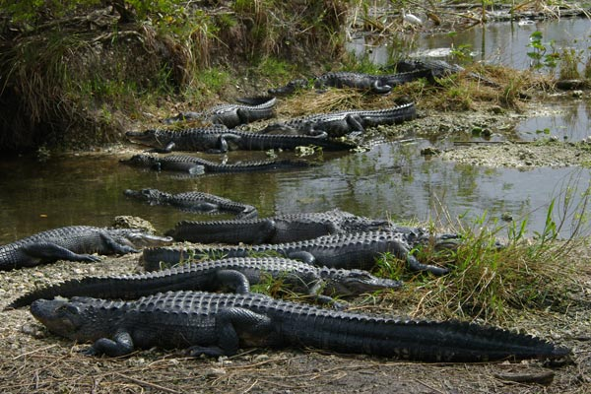
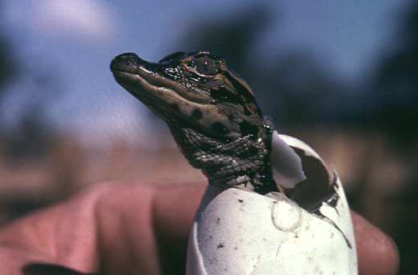
Your background research should answer questions needed to develop a valid experiment:
What is the average size of an alligator and how fast do they grow?

Slide 14
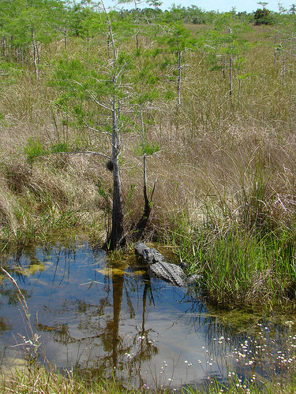
Your background research should answer questions needed to develop a valid experiment:
What larger role do alligators play in their ecosystem?

Slide 15
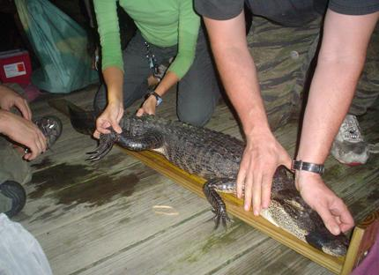
Your background research should answer questions needed to develop a valid experiment:
How do you measure an alligator?

Slide 16
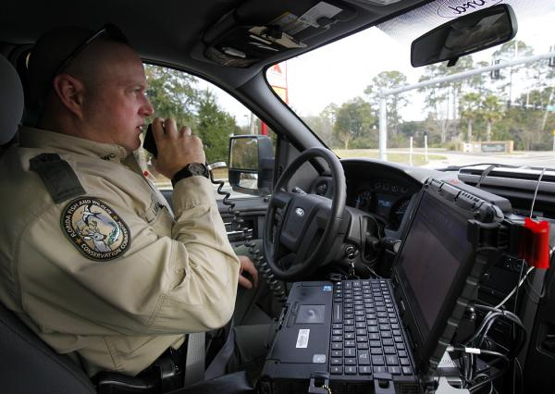
Your background research should answer questions needed to develop a valid experiment:
Do I need special permission or permits to handle alligators?

Slide 17
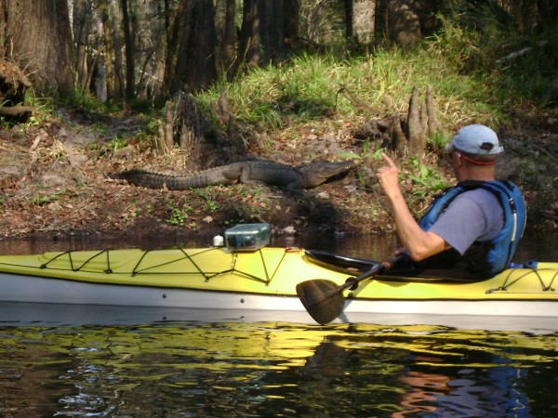
Your background research should answer questions needed to develop a valid experiment:
How do you measure an alligator in the field?

Slide 18
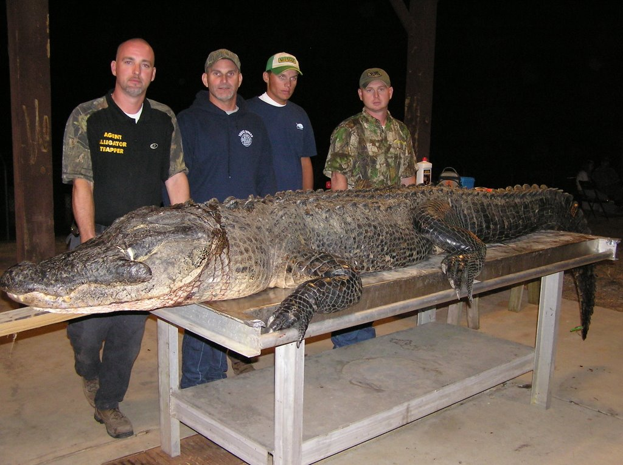
Your background research should answer questions needed to develop a valid experiment:
What is the largest alligator ever recorded?

Slide 19
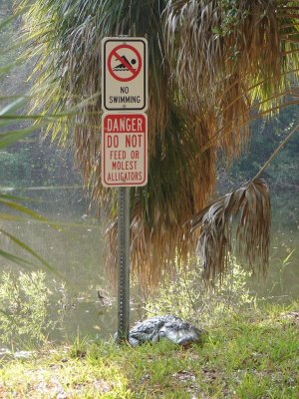
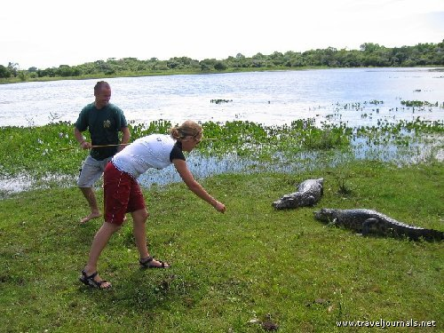
Your background research should answer questions needed to develop a valid experiment:
What dangers exist working with alligators?
What safety precautions should I take?

Slide 20
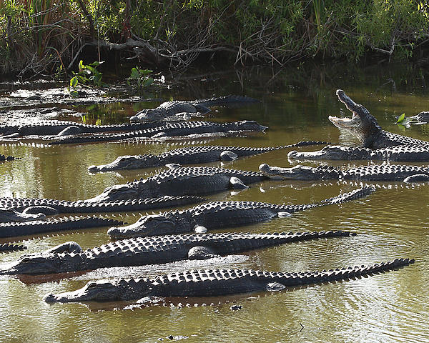
Your background research should answer questions needed to develop a valid experiment:
How many subjects should I test?
How many trials should I conduct?

Slide 21
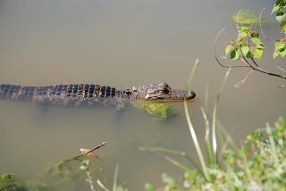
Your background research should answer questions needed to develop a valid experiment:
How do I avoid bias in my procedures?

Slide 22
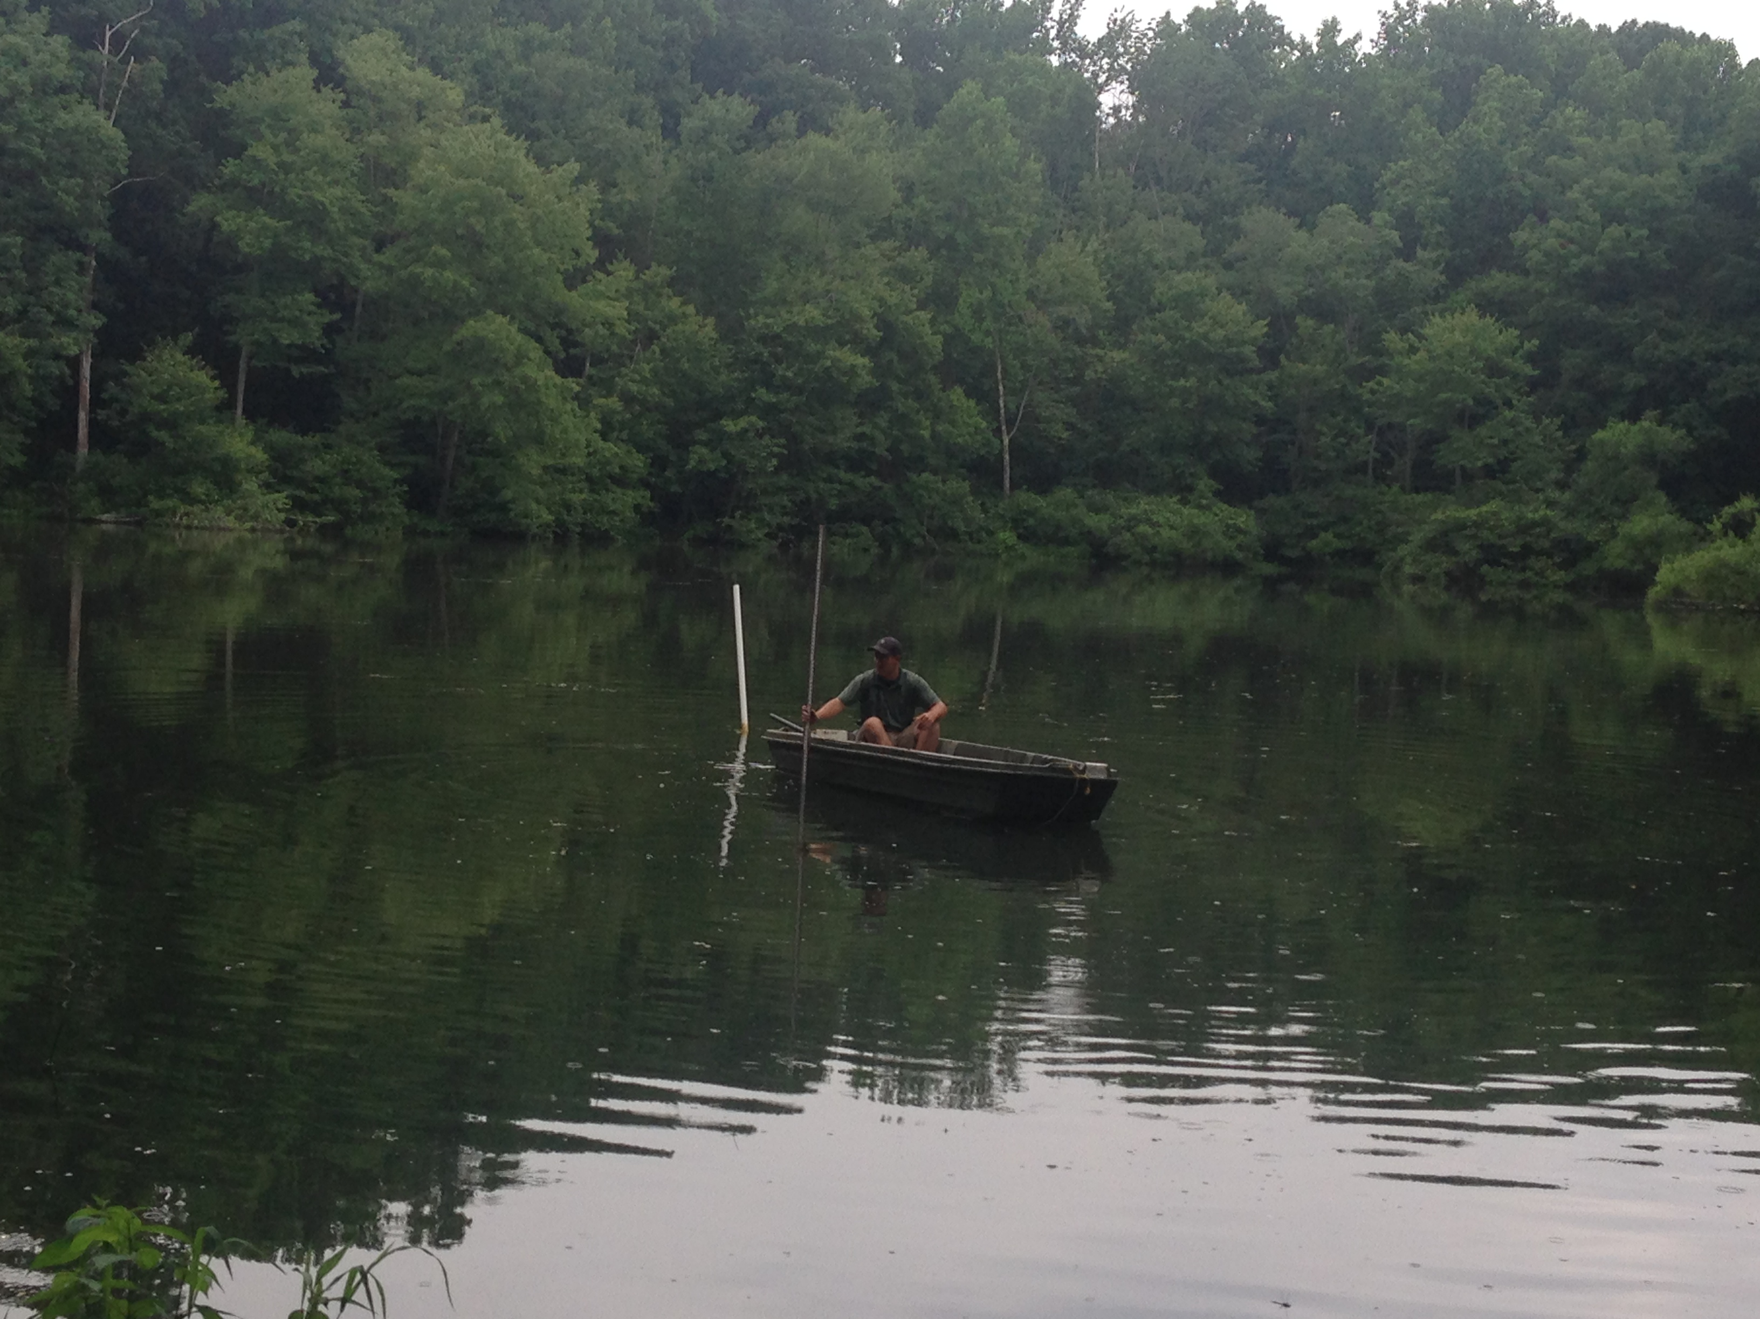
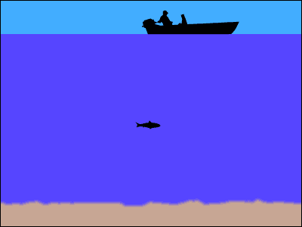
Your background research should answer questions needed to develop a valid experiment:
How do I measure the depth of a pond?

Slide 23
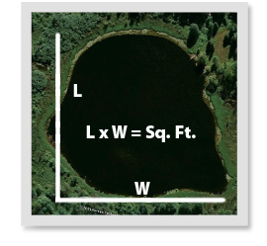
Your background research should answer questions needed to develop a valid experiment:
How do I estimate the size of a pond?

Slide 24
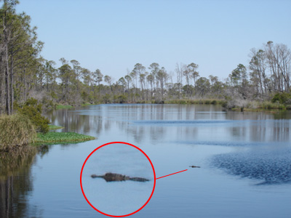
Your background research should answer questions needed to develop a valid experiment:
Has this been studied before? What is already known?

Slide 25
Good Essential Research Questions for ALL projects:
What are the characteristics of a well designed experiment?
How do you reduce experimental bias?
Good questions for projects with Human Subjects:
How many subjects should I test?
How should I select human subjects for my experiment?
How do I write an unbiased survey?

Slide 26
Find a minimum of 5 sources of information to answer your essential research questions.
Create a bibliography of your 5 sources using APA or MLA styles.
Agency maintaining website
Title
Date viewed
Publication date
American Alligator (Alligator mississippiensis). (n.d.). National Geographic. August 22, 2014. http://animals.nationalgeographic.com/animals/reptiles/american-
alligator.html
INCLUDE FULL WEBSITE ADDRESS!!!!
Complete web address

Slide 27
Sample Bibliography (MLA style)
"Battery." Encyclopedia Britannica. 1990.
"Best Batteries." Consumer Reports Magazine 32 Dec. 1994: 71-72.
Booth, Steven A. "High-Drain Alkaline AA-Batteries." Popular Electronics 62 Jan. 1999: 58.
Brain, Marshall. "How Batteries Work." howstuffworks. 1 Aug. 2006 <http://home.howstuffworks.com /battery.htm>.
"Cells and Batteries." The DK Science Encyclopedia. 1993.
Dell, R. M., and D. A. J. Rand. Understanding Batteries. Cambridge, UK: The Royal Society of Chemistry, 2001.
"Learning Center." Energizer. Eveready Battery Company, Inc. 1 Aug. 2006 <http://www.energizer.com /learning/default.asp>.
"Learning Centre." Duracell. The Gillette Company. 31 July 2006 <http://www.duracell.com /au/main/pages/learning-centre-what-is-a battery.asp>
Alphabetical Order
From: http://www.sciencebuddies.org

Slide 28
Special Bibliography Instructions for projects involving:
Human subjects – one source must document the ethical considerations and basic human rights afforded to human subjects involved in scientific research.
Vertebrate animals - one source should address animal care techniques for the species you are working with
Microorganisms - one source should address standard procedures for handling and working with potentially hazardous biological agents.
Chemicals – include Material Safety Data Sheets (MSDS) as a source to ensure proper safety precautions are taken.

Slide 29
What Next?
Before next week……
In your Project Journal, create a list of 10 essential research questions.
Find sources to answer research questions. Create a bibliography (typed) with a minimum of 5 sources.
3. Visit the science fair RULES WIZZARD and determine what forms you need.
4. Start filling out forms, thinking ahead of details needed in your Research Plan, our topic next week!

