Slide 1
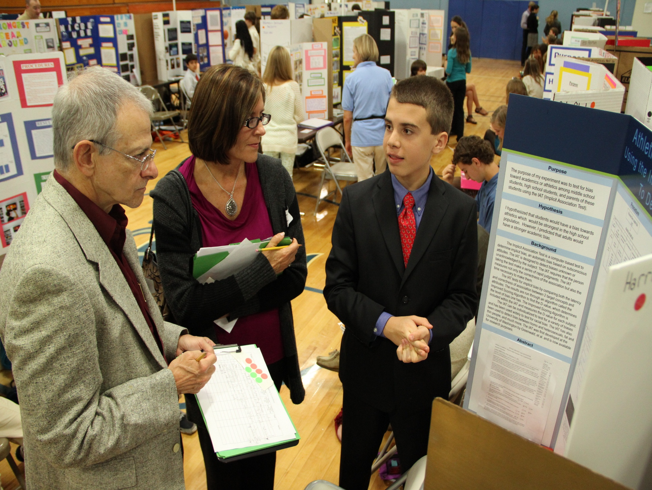
Science Fair
2017-18

Slide 2
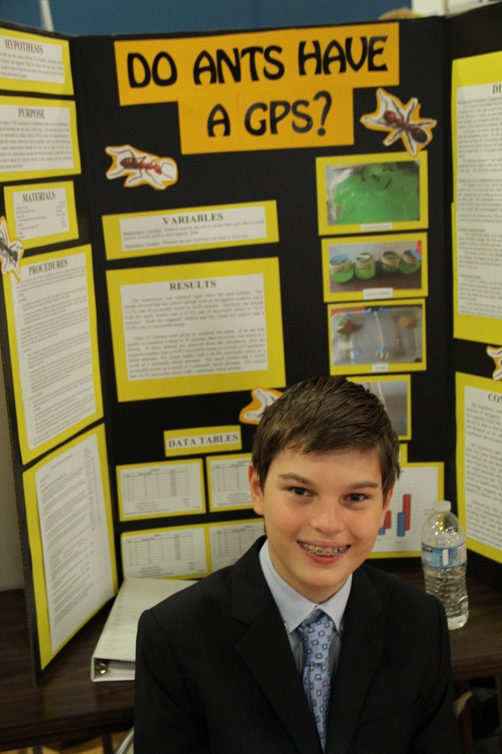
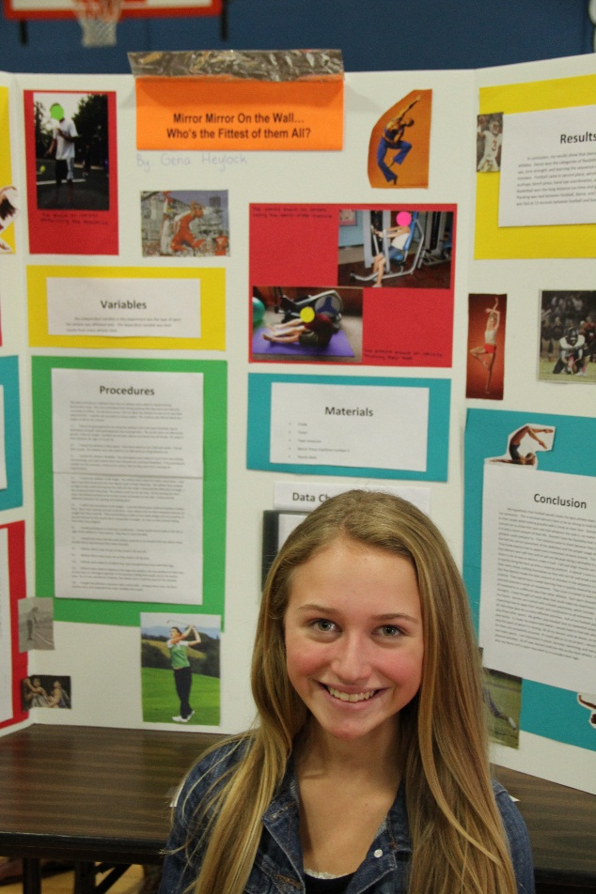
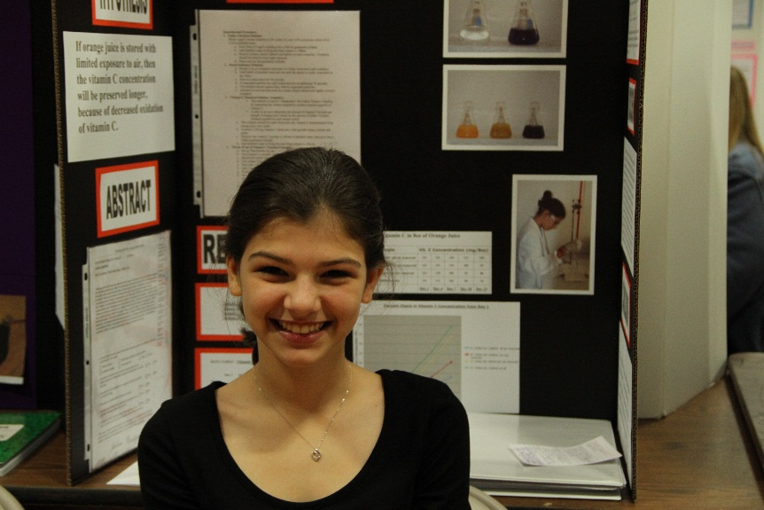
The Landrum Middle School Science Fair is affiliated with:
The St. Johns County Science Fair
Florida State Science and Engineering Fair (SSEF)
Intel International Science and Engineering Fair (ISEF)

Slide 3
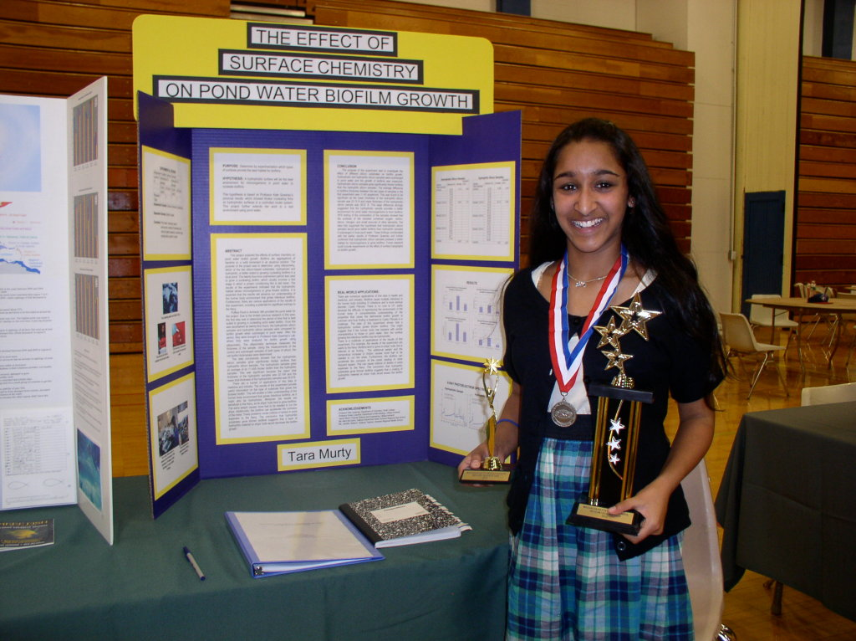
Parts of the Science Fair Project
Backboard –
Presents your entire experiment
Project Binder Contains paperwork, background research, and project report.
Project Journal - A diary of your project. A record of everything you did.

Slide 4
What are the Judges Looking For?
Projects that:
Are Meaningful
Have real world applications
Have a clear purpose
Solve a real-world problem
Address a issue in your community
Are challenging
Steer clear of “typical” or commonly-done projects with obvious outcomes (ScienceBuddies.com)
Models and demonstrations, while educational, are not Science Fair projects!

Slide 5
Where Do I Begin?
Topic selection is the hardest part!
Use imagination, thoughtfulness, independence, and diligence.
Pursue topics that interest you.
Use current events to inspire you.
Address questions of local or regional concern.
Try to answer an unanswered question, solve a problem, invent something, or improve something.

Slide 6
Project Journal
EVERY student needs to keep a project journal
EVERYTHING you do should be recorded in
your project journal (not just your
experimental data).
DATE every entry – extremely important!!!
Use non-erasable pen, not pencil.
Do NOT tear out pages, use white out, or scribble out mistakes.
Draw ONE line (mistack) through any mistakes.
Your journal should document the process of selecting a topic, background research, rough drafts of your Research Plan, your data – EVERYTHING! -- START MAKING ENTRIES TODAY!
Mr. Anzelmo
Science Fair

Slide 7
Sample Entry
8/22/17
Attended first Science Fair Checkpoint meeting. Discussed project components and filled out Student Entry Form. Will need to visit science fair website: http://www.lms.stjohns.k12.fl.us/sciencefair/
My first topic idea deals with methods to reduce plastic consumption by using...

Slide 8
Can I Start Experimenting?
NO
You must first:
1) Conduct background research and create a bibliography
2) Create a detailed Research Plan
3) Complete all of the Official ISEF forms needed for your project and receive project approval
These tasks must be completed BEFORE any experimentation can begin!!!
Winning students can advance to the St. Johns County Science fair and the Florida State Fair, and potentially win monetary awards and college scholarships!

Slide 9
EVERY student fills out their own form!
MUST be parent email!

Slide 10
What Next?
1.Fill out your Student Entry form and turn in either today or next Tuesday.
2. Get a Project Journal and start making entries.
3. Visit the Landrum Science Fair website and familiarize yourself with upcoming due dates
4. Start looking for sources of background information for your project, which is our topic next week!

Slide 11
What are the Judges Looking For?
Your project should:
Use quantifiable (measureable) variables.
Have measurable results (time, distance, capacity, temperature, frequency, changes in rates, scale rankings…...)
Product tests should be avoided unless you test the chemical or physical properties of specific ingredients.
* Your project must address why there may be a difference in the effectiveness between products based on chemical or physical properties.

